Slide 1
Stress, Cognitive Control, and The Wandering Mind: Can Mindfulness Help?
Dr. Jonathan Banks

Slide 2
What is stress?
Events in the environment?
An internal state?

Slide 3
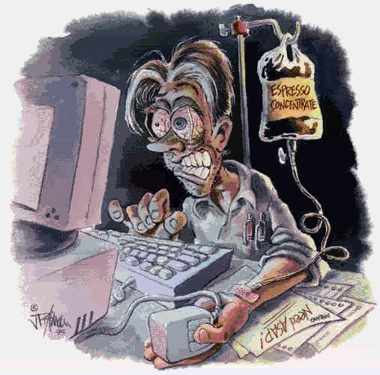
Stress
What are some things that stress you out?

Slide 4



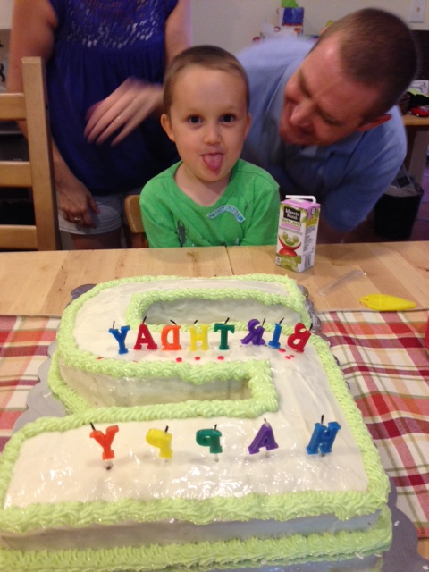

Slide 5




Slide 6
Two Stress Pathways
1) Hypothalamus – Adrenal Medulla (SAM)
  First response (epinephrine)
2) Hypothalamus – Pituitary – Adrenal Cortex (HPA)
  Secondary response
  Cortisol
    imummosuppressor

Slide 7
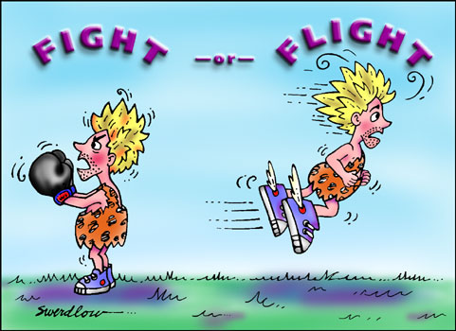
Stress and Health
Males: Fight or Flight Syndrome
  Hypothalamus releases cortico-steroids
    Blood vessels, muscles, and brain constrict
    Sweat, heart rate, breathing increase

Slide 8
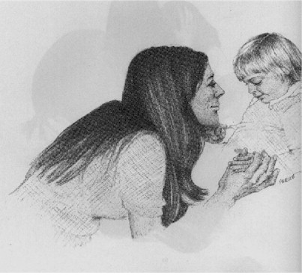
Stress and Health
Females: Tend and Befriend
  Ensure safety of offspring by tending to their needs
  Befriend others to help protect offspring

Slide 9
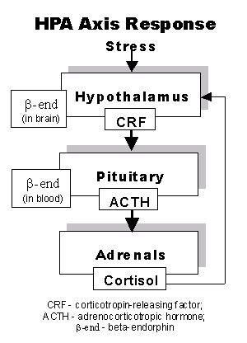
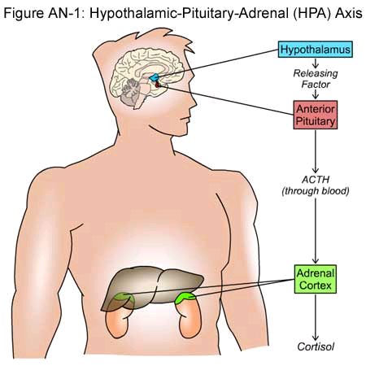
Cortisol
Increases blood sugar
Breaks down protein and fats
In severe stress, increases 10x
Anti-inflammatory
Immunosuppresive

Slide 10
What about the impact on Cognitive performance?
Attention
Working memory
Applied: Exams

Slide 11
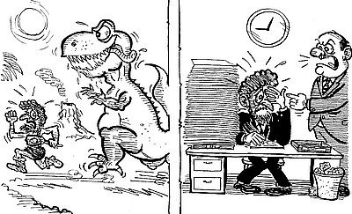
Evolutionary Perspective

Slide 12
Hurt or Help
Should stress hurt or help cognitive performance?
It depends
  On the cognitive function

Slide 13
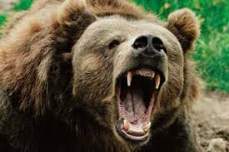
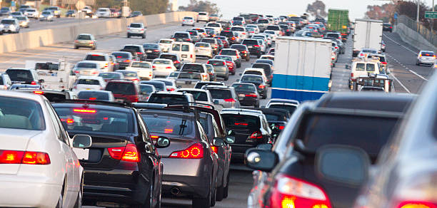
What should be helped by stress?
Anything that helps running from a predator
  Only for Acute not chronic stress

Slide 14
What is hurt?
Everything else---
    Decision Making (Baradell & Klein, 1993)
    Problem Solving (Klein & Barnes, 1994)
    Working Memory (Klein & Boals, 2001a; Sliwinski, Smyth, Hofer, & Stawski, 2006)
    Everyday Cognitive Failures (Boals & Banks, 2012)
    Executive Functioning (Eysenck et al., 2007)
      Shifting
      Inhibition
      Updating

Slide 15
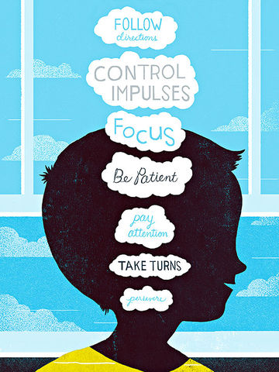
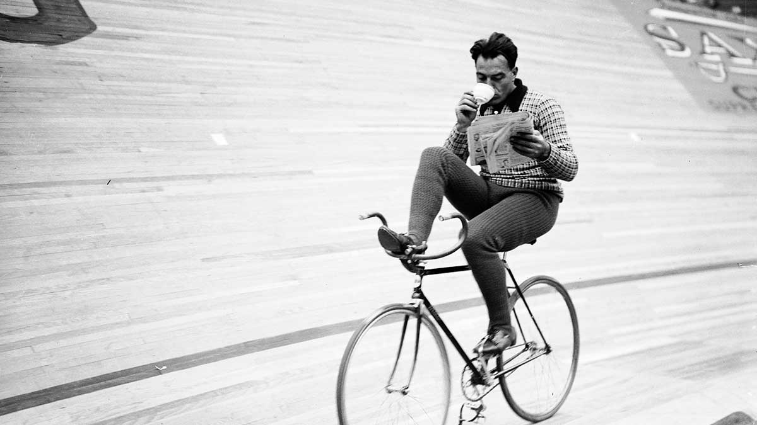
The working memory system
Rehearsal is coordinated by the central executive.
  “A multi-purpose processor capable of running many
  different operations on many different types of material”
Tied closely to attention – attending to something
involves its’ incorporation into working memory
The executive deals with response
selection, planning, goal setting
It also initiates the rehearsal loops
Notes:
Notion of a central executive
Capacity limits of working memory

Slide 16
Figure 4.1 A schematic representation of Baddeley's Working Memory. The phonological loop is made up of the articulatory control process and the phonological store, and the corresponding process and store for visuo-spatial information are the visuo-spatial sketchpad and the visual scribe. Source: Based on descriptions from Baddeley (2000) and Baddeley & Logie (1999).

Slide 17
  Executive Attention Model of Working Memory (Kane, Conway, Hambrick, & Engle, 2007)
Working memory is responsible for the control of executive attention.
  Thus predicts inhibitory control (Engle, 2004):
    Stroop (Kane & Engle, 2003)
    Antisaccade (Unsworth, Schrock, & Engle, 2004)
  Fluid Intellegence (Engle & Kane, 2004)
  Mind wandering (McVay & Kane, 2009)
    Task Unrelated Thoughts

Slide 18
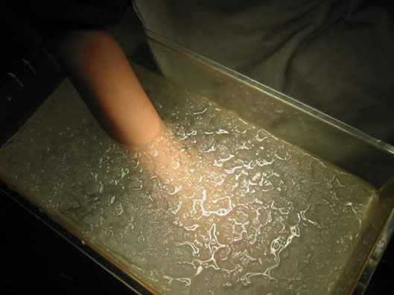

Why does stress impair these functions?
Depends on the type of stress?
  Physical vs Psychological
  Acute vs Chronic

Slide 19
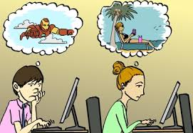

Psychological
Mind wandering (Task-unrelated thoughts-TUTs)
  50% of our daily life (Killingsworth& Gilbert, 2010)
  Wegner (1994)- Ironic Process

Slide 20
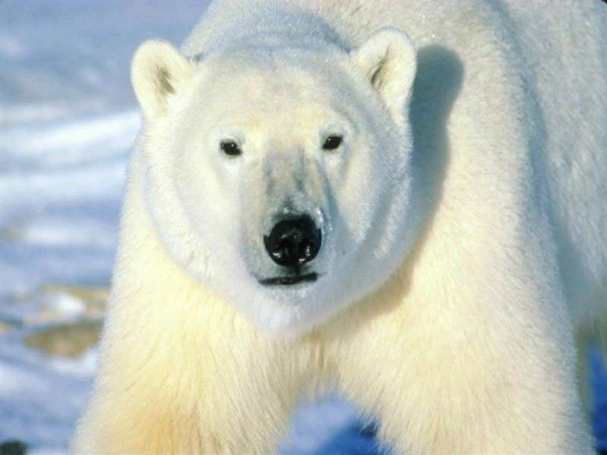

Slide 22
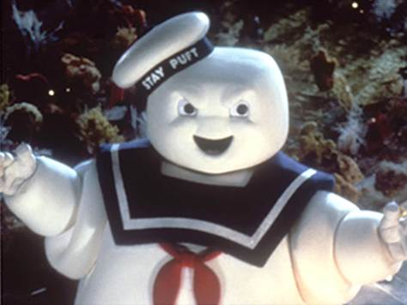

Slide 23
Working Memory and Mind Wandering
Control of Executive Attention (Kane, Conway, Hambrick, & Engle, 2007)
Control over Mind Wandering (McVay & Kane, 2010)
  But…Mind Wandering impairs performance (Randall, Oswald, & Beier, 2014)
Working Memory
Mind Wandering

Slide 24
Mind Wandering
-
-
Working Memory
Cognitive Task Performance
(SUSTAINED ATTENTION)
+

Slide 25
Banks, Tartar, & Tamayo, 2015
We were interested understanding the role of mind wandering, or Task Unrelated Thoughts (TUTs), and cortisol in stress related working memory impairments.
Psychological stress manipulation
  Negative life event
We hypothesized that at baseline the percentage of TUTs would mediate the relationship between State Anxiety and WM
  Cortisol should moderate the impact of TUTs on WM
Additionally, the stress manipulation would increase percentage of TUTs and subsequently decrease AOSPAN performance.

Slide 26
Methods
60 undergraduates (43 women, M age = 21.07, SD= 3.30) from Nova Southeastern University
Baseline Measures (Time 1)
AOSPAN (w/ Thought Probes)
STAI-ST
Saliva Sample
Stress Writing Task
Negative event or Control
Post writing measures
AOSPAN (w/ Thought Probes)
STAI-ST
Saliva Sample
“During today’s session, I want you to let go and write about your deepest thoughts and feelings about the negative event you nominated. In your writing, you might want to explore your emotions and thoughts about the negative event.”

Slide 27
Thought Probes
(a) task-related thoughts, exclusively,
(b) task performance/evaluative thoughts (positive)
(c) task performance/evaluative thoughts (negative)
(d) everyday stuff
(e) current state of being
(f) daydreams
(g) other TUTs

Slide 28
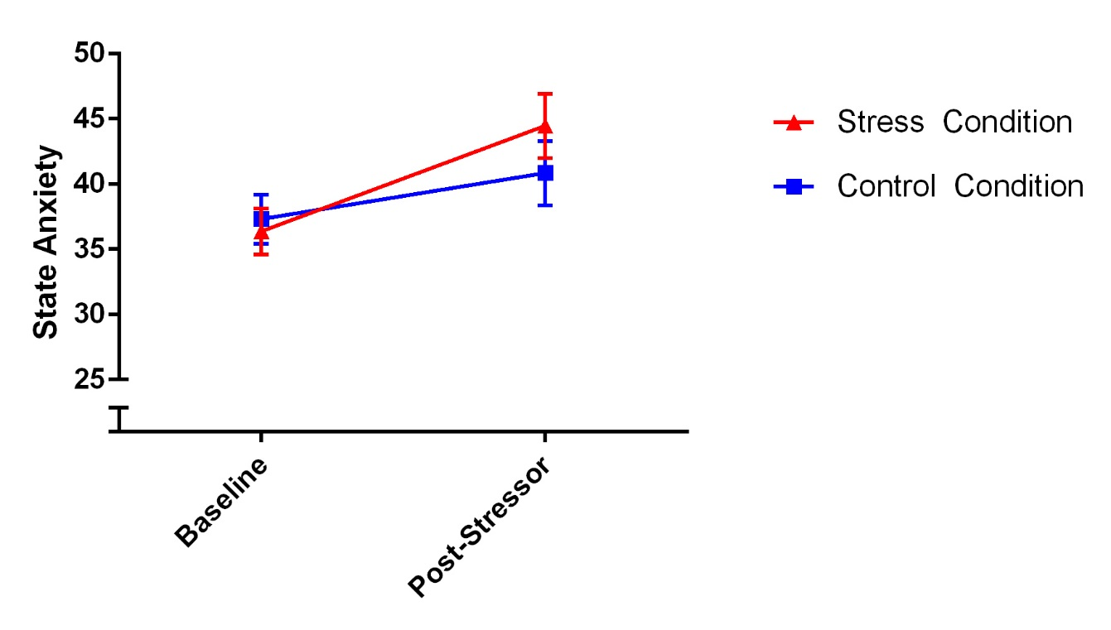
Stress Manipulation
No effect of time, condition, or time by condition interaction on AOSPAN task performance, p > .05
Significant time x condition interaction on state anxiety, F(1, 56)= 4.19, p <.05, partial η² = .07, with a greater increase in the stress condition, t(56) = 2.05, p < .05, d = 0.36.

Slide 29
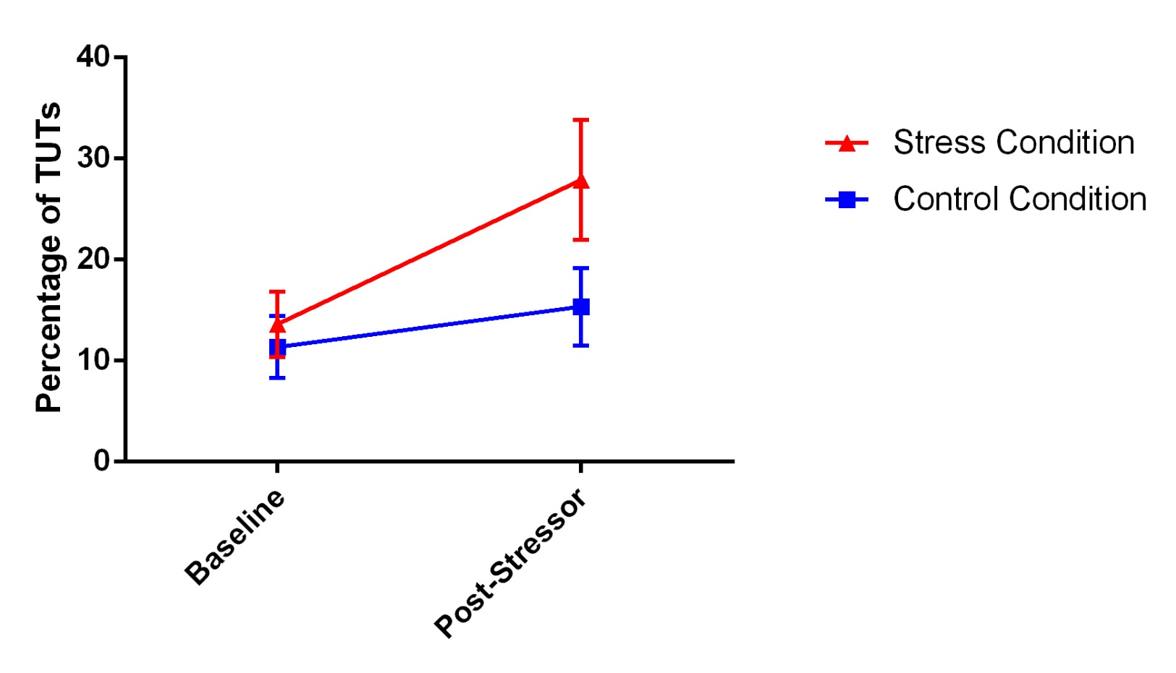
Change in TUTs
Significant increase in TUTs over time, F(1, 56) = 8.77, p <.01, partial η² = .16, but the effect is driven by increases in the stress condition, t(27) = 2.70, p < .05, d = 0.55.

Slide 30
Does Mind Wandering Mediate the Relationship between State Anxiety and WM?
TUTs
-28.81*
0.006*
State Anxiety
AOSPAN
c= -.37, c’ = -.20
A mediation analyses revealed a significant indirect effect of State Anxiety on AOSPAN task performance that is mediated by TUT percentage, Indirect effect = -.17, Bootstrapped SE = .11, Bootstrapped 95% CI [-.50, -.03]
Note: Values represent unstandardized path coefficients, * p < .05

Slide 31
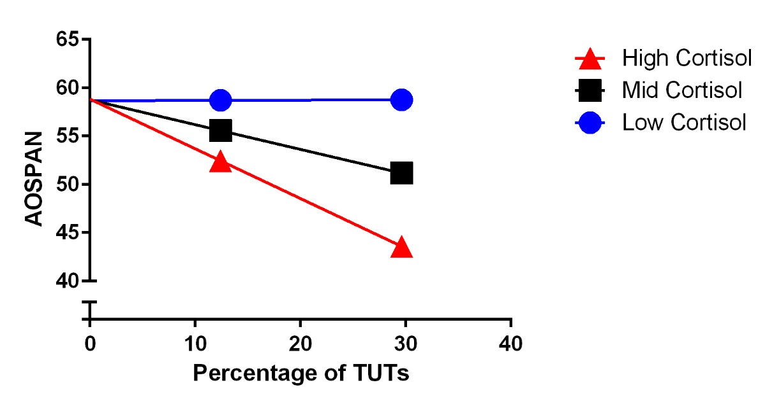
Does Cortisol Moderate the Impact of TUTs on WM?
TUTs have a negative impact on AOSPAN performance at mean levels of cortisol, b = -25.64, SE = 10.86, p < .05, 95% CI [-47.41, -3.86], and at higher levels of cortisol, b = -51.54, SE = 14.12, p < .001, 95% CI [-79.85, -23.24].

Slide 32
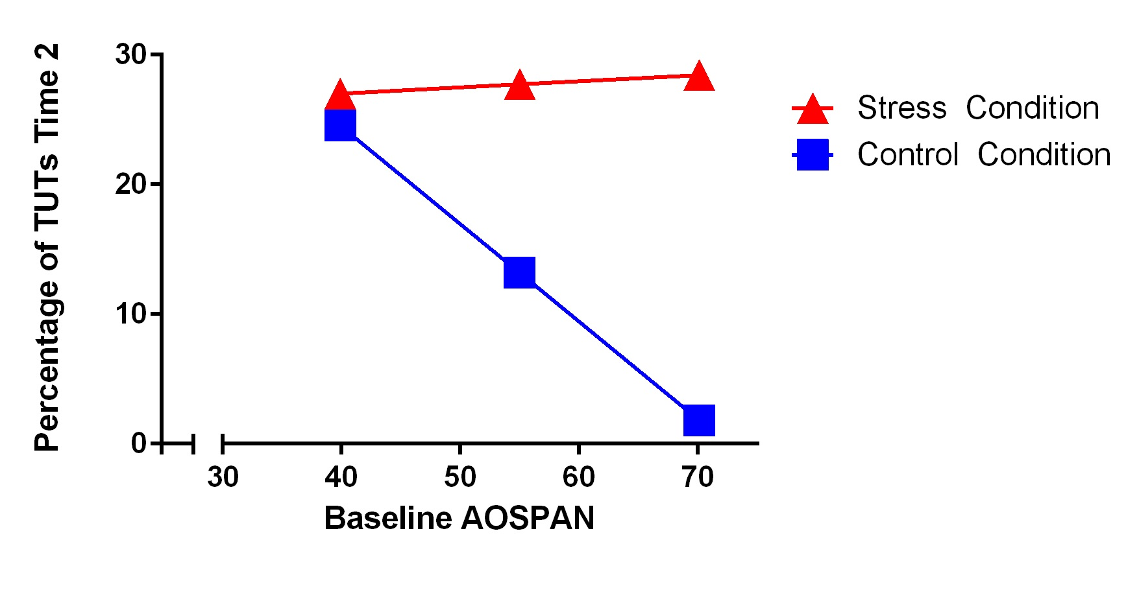
Impact of Baseline AOSPAN Performance on TUTs at Time 2 by Condition
In the control condition, baseline AOSPAN task performance scores predicted TUTs, β = .43, t(1) = 2.33, p < .05, but not in the stress condition.

Slide 33
Banks & Boals, 2016
Examined the impact of a positive, negative, or neutral writing manipulation on mind wandering and working memory
Participants wrote about a future event
Also, examined the role of daily stressors on working memory and mind wandering
Hypotheses:
  Writing about a future negative, but not positive or neutral event, will result in increases in TUTs and decreases in WM task performance.
  TUTs will mediate the relationship between life stress and WM task performance

Slide 34
150 undergraduates (84 females; M age = 21.28 years) at the University of North Texas (50 per condition).
N = 126 Session 2 (Positive event condition n = 41; Negative event condition n = 45); Control event condition n = 40)
Session 1
Session 2
Baseline Measures
AOSPAN and RSPAN
    (With Thought Probe)
    Daily Inventory of Stressful Events White Bear Suppression Inventory
Writing Task
Future Negative
Future Positive
Control
Post writing measures
AOSPAN and RSPAN
    (With Thought Probe)
    Daily Inventory of Stressful Events Life Experiences Scale
    Impact of Events Scale

Slide 35
Thought Probes
Task-related thought, exclusively,
Task performance/evaluative thoughts,
Task-unrelated, neutral content,
Task-unrelated, positive content,
Task-unrelated, negative content.
Task-unrelated, about the event I wrote about. (Time 2 only)

Slide 36
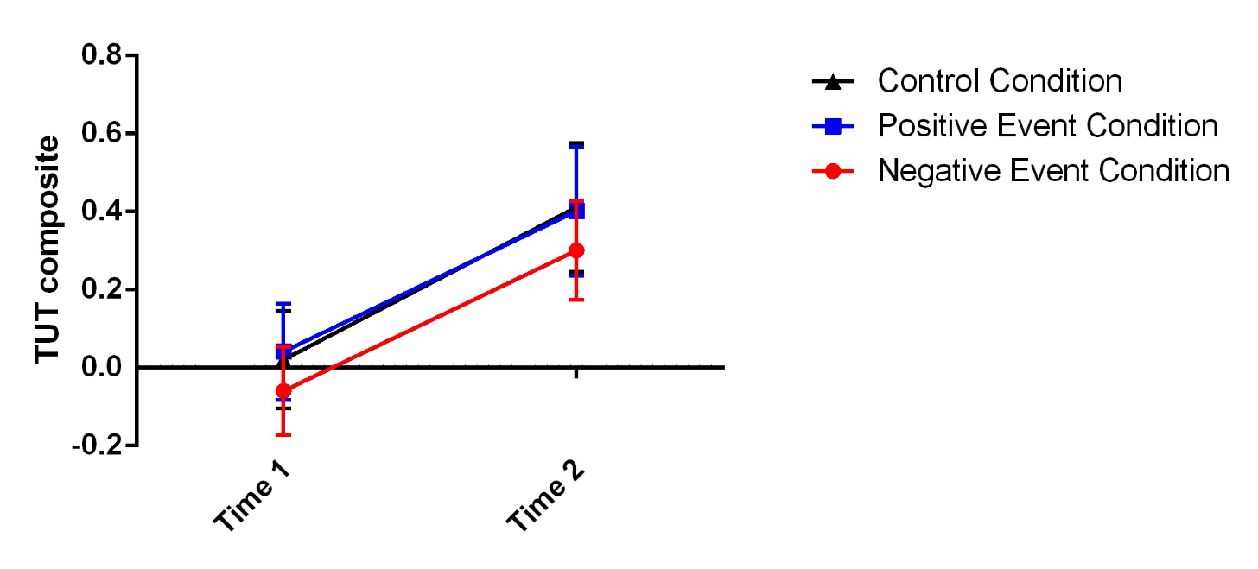
Effect of Writing Manipulation
No effects of condition, time, or time by condition interactions were found for the WM composite score, all p’s > .05.
A significant effect of time was found on the TUT composite, F (1,123) = 24.66, p < .0001, partial η² = 0.16, such that TUTs increased from Time 1 (M = 0.00, SD = 0.84) to Time 2 (M = 0.37, SD = 0.98).

Slide 37
Does Mind Wandering Mediate the Relationship between WM at Time 1 and Time 2?
TUTs T2
-0.43****
-0.14*
Working Memory Composite T2
Working Memory Composite T1
C’ 0.79****(C 0.83****)
Indirect effect = 0.06, bootstrapped SE = 0.02, bootstrapped 95% CI [0.2, 0.14].

Slide 38
Does Mind Wandering Mediate the Relationship between Stress and WM?
TUTs T1
0.08*
-0.64****
Working Memory Composite T1
DISE T1
C’ 0.04 (C -.01)
Indirect effect = -0.05, bootstrapped 95% CI [-.11, -0.01], Kappa = .11.
Note. Values represent unstandardized path coefficients. p < .05*, p<.0001****, N =150

Slide 39
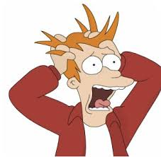
So what do we know?
Stress stinks……
Stress impairs Working Memory Task Performance
  Due to increases in Mind Wandering
Levels of Cortisol alter the impact of Mind Wandering on Task performance
  Probably an indirect marker for how physiologically stressed someone is.

Slide 40

Can we fix it?

Slide 41
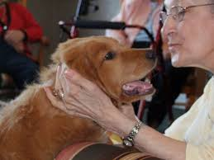
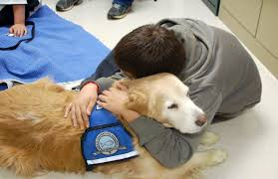
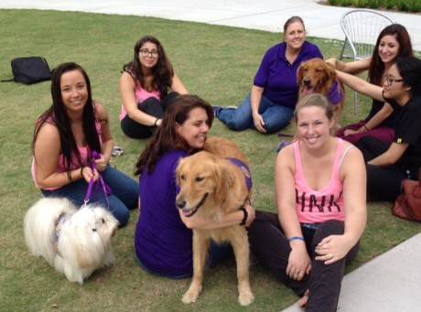
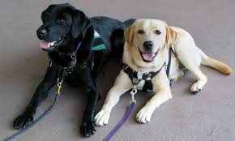
Canines?

Slide 42
Banks, McCoy, & Trzcinski (In press)
We examined the impact of interacting with therapy dogs for 10 minutes on stress and sustained attention in college students.
  56 Undergraduates from Nova Southeastern University (n =29 Canine Interaction Condition; n =27 Control Condition)
Participants completed measures of
  Self report stress (Perceived Stress Scale and State Anxiety Inventory),
  Sustained Attention (SART)
  Mind Wandering
We hypothesized that participants that interacted with the dogs would have lower levels of stress and mind wandering and higher levels of sustained attention than the control participants.

Slide 43

Results
There was no significant effect of canine interaction on mind wandering or sustained attention.
BUT………

Slide 44
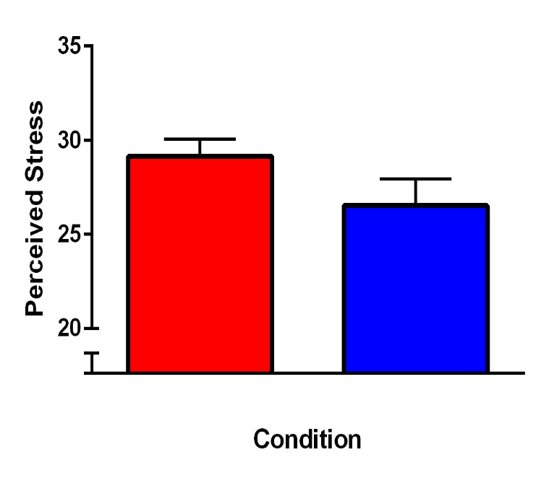
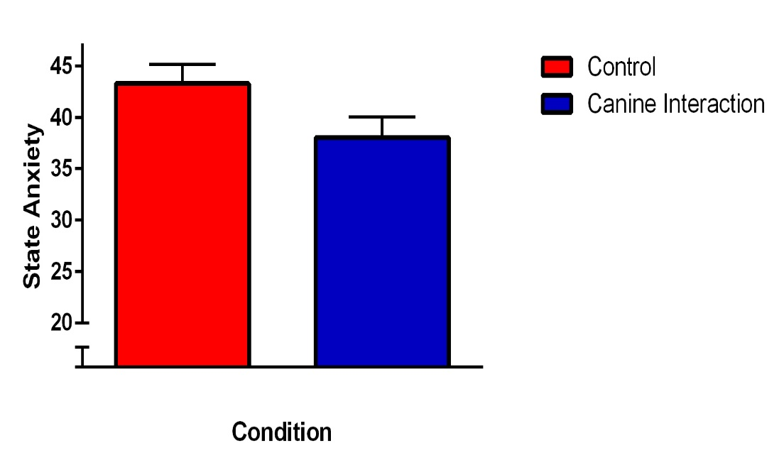
Condition was a significant predictor of both perceived stress (Adj. R² = .117, F(2,51)= 4.53, p =.015, β = -.27) and State Anxiety (Adj. R² = .107, F(2,48)= 3.98, p =.025, β = -.32).
Note: error bars represent standard error of the mean

Slide 45
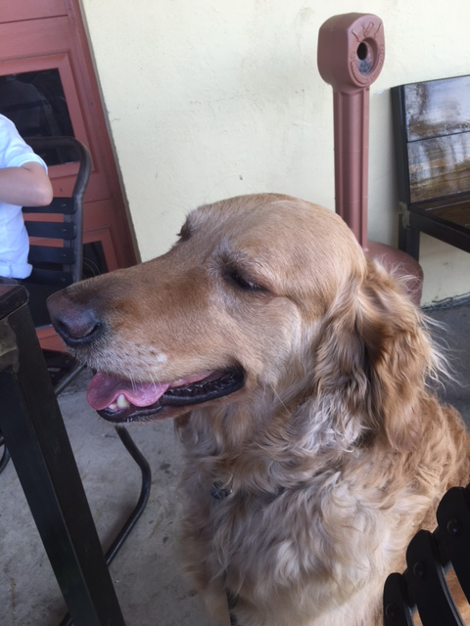
So….WE NEED MORE DOGS!
But what about the cognitive changes????

Slide 46
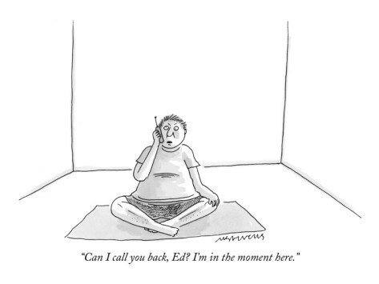
Mindfulness
What is mindfulness?
Improve awareness through increases in focused attention and through open monitoring of sensations without reactivity to the sensations or thoughts (Davidson & Goleman, 1977).

Slide 47
Impact on Cognition
Improve working memory and sustained attention in pre-deployment military cohorts (Jha, Morrison, Parker, & Stanley, 2016; Jha, Stanley, Kiyonaga, Wong, & Gelfand, 2010)
Greater engagement in mindfulness practice leads to improved sustained attention in athletes ( Rooks, Morrison, Goolsarran, Rogers, & Jha, 2017).

Slide 48
Mindfulness
Banks, Welhaf, & Srour, 2015
We were interested in examining the impact of a brief mindfulness training on working memory, mind wandering, and protection from a stressor
Participants completed either a one week at home mindfulness training or relaxation training.
We hypothesized that participants would demonstrate
  increase in WM task performance
  decrease in mind wandering
  reduced susceptibility to a stress manipulation.
  80 Undergraduates from Nova Southeastern University (n =40 Mindfulness Condition; n =40 Relaxation Control Condition)
  Session 2
    N = 62 (n = 34 Mindfulness condition; n = 28 Relaxation condition)

Slide 49
Session One
Baseline Measures (Time 1)
AAQ, PANAS,
AOSPAN
w/ Thought Probes
Mindfulness Meditation Training or
Relaxation Training
AOSPAN
w/ Thought Probes
(Time 2)
Session Two
Mindfulness or Relaxation recording
AAQ, PANAS,
AOSPAN
w/ Thought Probes
(Time 3)
AOSPAN
w/ Thought Probes
(Time 4),
PANAS
Psychological Stressor
(10 minutes)

Slide 50
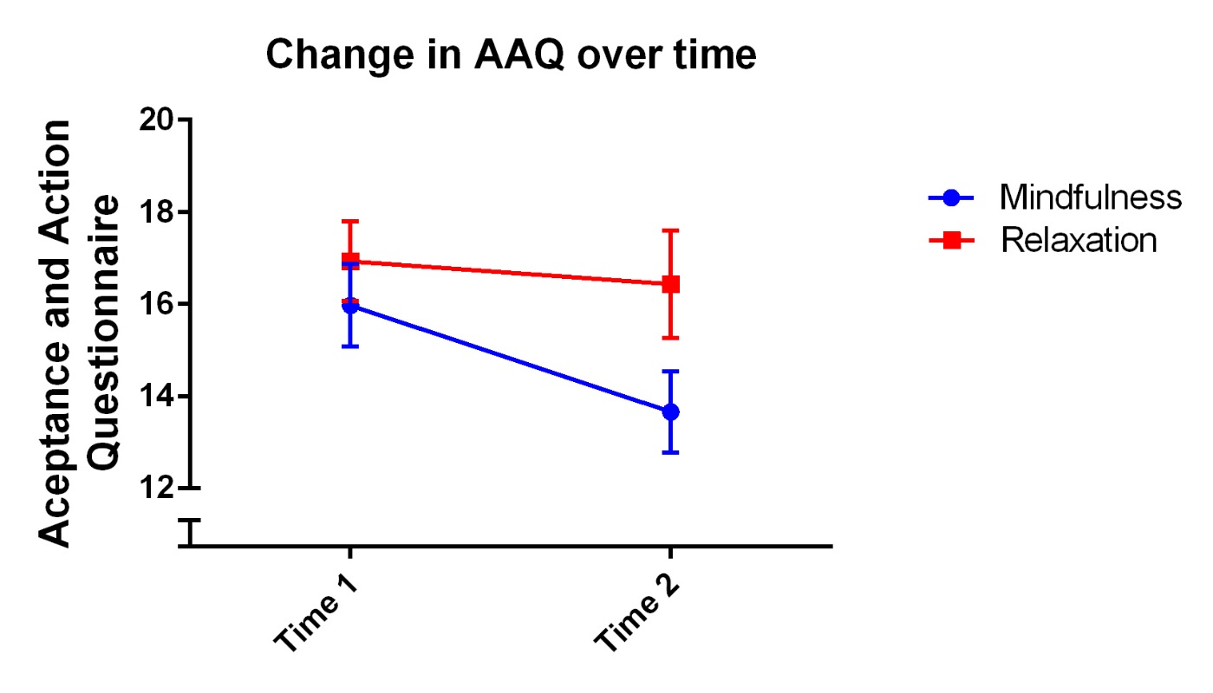
Changes in AAQ
Decreases in AAQ scores were observed in the MMT condition, t (34) = 3.94, p < .001, d = .40, 95% CI [1.12, 3.51] but not RT condition, t (27) = 0.63, p > .05, d = .008, 95% CI [1.12, 2.12].

Slide 51
Did Mindfulness Alter WM?
An effect of time, F (1,60) = 6.53, p < .05, partial η² = .34, condition, F (1,60) = 6.72, p < .05, partial η² = .11, and time by condition interaction, F (1,60) = 6.53, p < .05, partial η² = .34.

Slide 52
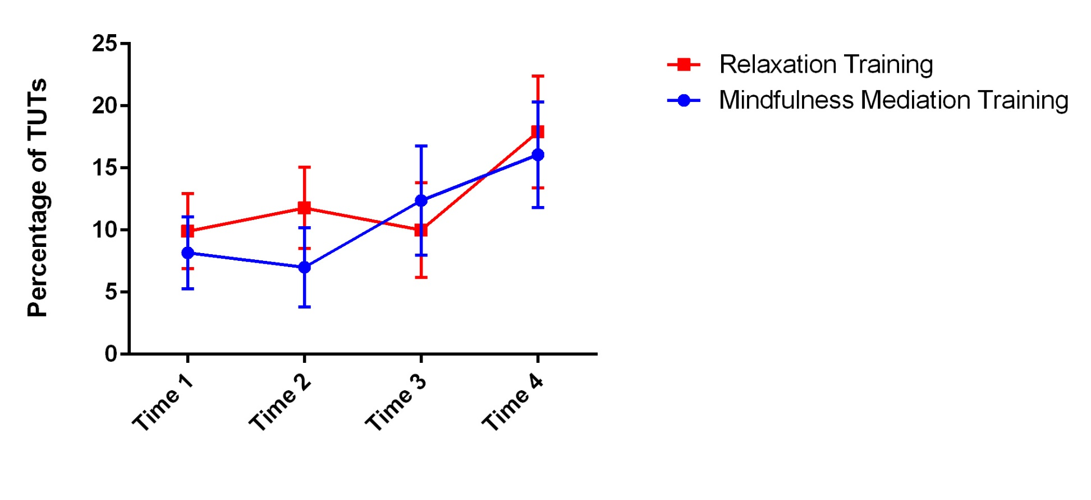
Did Mindfulness alter Mind Wandering?
No significant change from Time 1 to Time 3, p > .05. A trend for an effect of time (Time 3- Time 4) on TUTs, F (1,60) = 3.34, p = .07, partial η² = .06

Slide 53
So Why Does Mindfulness Help?
It appears to alter the impact of mind wandering on task performance.
But is all Mind Wandering the same?
Mind Wandering
Task Performance

Slide 54
Emotional Valence of Mind wandering
Most work has assumed that all types of TUTs impact task performance similarly.
  Look at overall percentage of TUTs
We hypothesized that negative not positive TUTs would hurt performance
  Greater capture of attention for negative vs. positive stimuli (Peeters & Czapinski, 1990)
  Disengagement (Compton, 2010)
  Thought suppression (Wegner, 1994)
    Individuals attempt to suppress negative thoughts (Petrie, Booth, & Pennebaker, 1998; Smart & Wegner, 1999)
    Suppression consumes resources
      (Klein & Bratton, 2007)

Slide 55
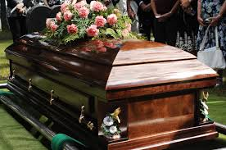
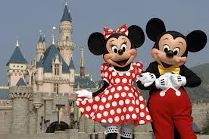



Slide 56
Banks, Welhaf, Hood, Boals, & Tartar (2016)
Reanalyzed data from three prior studies:
  Banks & Boals (2016)
    (N = 150)
    AOSPAN and RSPAN
  Banks, Tartar, & Welhaf (2014)
    (N = 53)
    SART
  Banks, Welhaf, & Srour (2015)
    (N = 80)
    AOSPAN
All measures reported in study collected at baseline

Slide 57
Thought probes used in all three studies
Please click on the button to indicate what you were just thinking about:
a.) Task-related thoughts, that is, pertaining to the current task
b.) Task-related evaluative thoughts – positive
c.) Task-related evaluative thoughts – negative
d.) Task-unrelated thoughts – neutral content
e.) Task-unrelated thoughts – positive content
f.) Task-unrelated thoughts – negative content

Slide 58
Results: Impact of TUT valence on WM performance
Banks, Welhaf, & Srour (2015)
  Overall percentage of neutral TUTs served as the only significant predictor of AOSPAN performance, β = -0.24, t = -2.05, p <.05.
    Overall model, F (3, 75) = 3.06, p = 0.033, Adjusted R² = 0.07.
Banks & Boals (2016)
  Overall percentage of neutral, β = -0.34, t = -4.94, p <.05, and negative TUTs, β = -0.46, t = -6.82, p <.05 served as significant predictors of AOSPAN & RSPAN performance.
    Overall model, F (3, 143)= 24.74, p < 0.0001, Adjusted R² = 0.33.
Banks, Tartar, & Welhaf (2014)
  NOGO accuracy predicted by RT, β = 0.52, t = 4.32, p <.05 & negative TUTs, β = -0.27, t = -2.10, p <.05
    Overall model, F (4, 44) = 8.47, p < 0.0001

Slide 59


Don’t worry be Happy

Slide 60
Mindfulness and Mind Wandering
We were interested in determining if a brief (15-minute) mindfulness meditation induction altered the impact of Negative TUTs on Sustained Attention Task performance.
  89 Undergraduate from Nova Southeastern University (n =31 Mindfulness Condition; n =27 Relaxation Control Condition; n= 31 Waitlist control)
Working Memory Tasks
Mindfulness/
Relaxation/ Nothing
Stress Manipulation
SART (with Thought Probes)

Slide 61
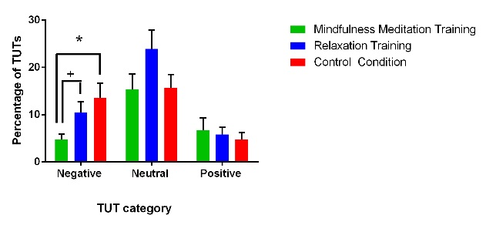
Results
No difference between groups on SART accuracy, F (2,84) = 0.06, p =.944.
Trend for a difference between groups on percentage of Negative TUTs, F (2,86) = 2.92, p =.059.
*p < .05, ⁺p = .15

Slide 62
Do Negative TUTs Hurt?
Negative TUTs predict poorer SART performance in the
  Relaxation condition (β= -.61, p=.008),
  Approach significance in the Control condition (β= -.36, p=.059)
  But not the mindfulness condition (β= -.29, p=. 13)

Slide 63

How does Mindfulness help?
It appears that Mindfulness may alter the impact of Negative off task thoughts so that task performance is not harmed.

Slide 64
Thank you to my team of undergraduate and graduate students:
  Matthew Welhaf
  Audrey Hood
  PJ Branceleone
  Lindsay Craig, Haley Hickey, Eddie Zacka, Amanda Holtzman, Danica Buse, Alyssa Boltson, Brianna Thompson, Alyssa Garcia, Heather Barkman, Chethani Chitraacharige, Lauren Gispert, Yuri Castro Flach, Samantha Rodriguez

Slide 65

Thank you!
“Be Mindful of your thoughts, Anakin. They Betray you.”- Obi-Wan Kenobi

